Slide 1

B. Tech. Project AY 2024-25
First Presentation (CA-1)
ProjectID: 16
Title of the Project: Anomaly Detection in Network Traffic
Name of the Guide: Dr. Pooja Kamat
Name of the Co-guide:
Group Members:
Kanika Gulati 21070126046
Kermi Kotecha 21070126049
Saumit Kunder 21070126078

Slide 2
Outline of the Presentation
Names of all the group members and their work distribution
Introduction
Problem Statement
Objectives of the Project
Project plan with timeline
Literature Review
Gap in the Research/ Technology/ Methodology
Description of the proposed solution
Requirement Analysis
Technology Stack
Design
Development/ Implementation
Testing & Debugging
Project Outcome
Conclusion
References
A photograph of the presentation after due permission from the guide.

Slide 3
Introduction
The reliance on digital infrastructure by businesses and governments has heightened the risks of network breaches, leading to severe financial and reputational damage.
This project centers on Anomaly Detection in Network Traffic, using machine learning to identify unusual patterns or deviations that may signal potential cyber threats.
The motivation lies in the need for proactive, intelligent systems that can detect anomalies in real-time, enabling faster and more effective responses to security breaches.

Slide 4
Problem Statement (by CDAC)
The primary challenge addressed in this project is the detection of anomalies in network traffic that could indicate the presence of cyber-attacks, such as Distributed Denial of Service (DDoS) attacks or unauthorized intrusion attempts. The goal is to develop a machine learning model that can effectively distinguish between normal network activities and suspicious activities in real-time, providing early warnings of potential threats.

Slide 5
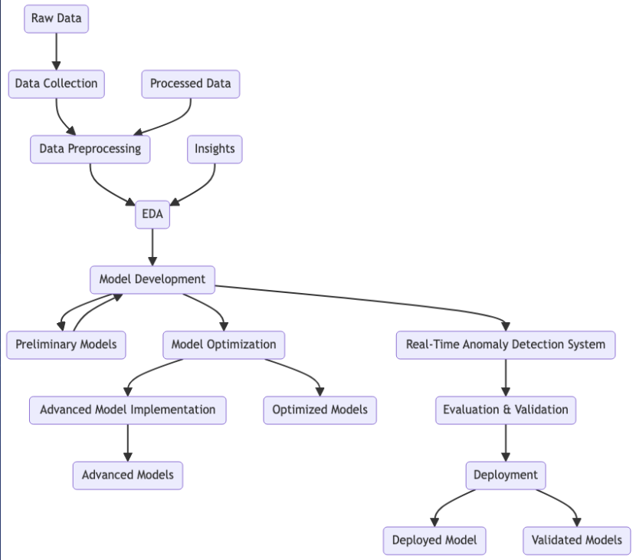
Workflow

Slide 6
Project timeline
Week 1: Planning & Data Collection
Finalize project scope, including LLMs.
Collect and preprocess data.
Explore LLMs for early predictive maintenance.
Week 2: Initial Models & LLM Setup
Develop machine learning models (KNN, SVM).
Set up LLMs for log analysis and predictive maintenance.
Week 3: Model Evaluation & LLM Integration
Train models, integrate LLMs for early anomaly detection.
Tune hyperparameters for both.
Week 4: Advanced Deep Learning & LLM Refinement
Develop advanced deep learning models (Bi-LSTM, Autoencoders).
Refine LLM predictions for early warnings.
Week 5: Results Analysis & LLM Contingency Plans
Analyze model results, implement LLM-based contingency plans.
Week 6: Final Report & Presentation
Finalize report and presentation, highlighting LLM-enhanced predictions.

Slide 7
Literature Review
S.no | Title | Objectives | Year | Techniques Used | Results
1. | AI-Driven Anomaly Detection in Network Monitoring Techniques and Tools | Examine how AI and machine learning techniques can improve anomaly detection capabilities for network monitoring systems. | 2024 | Clustering, Isolation Forest, Autoencoders, Recurrent Neural Networks (RNNs), Machine Learning Models | AI-driven approach improved detection rates of synthetic network attacks compared to traditional threshold monitoring; achieved an average detection rate of 89% with a 2.4% false positive rate.
2. | Anomaly Detection in Cloud Network: A Review | Review various strategies, datasets, and challenges associated with anomaly detection in cloud networks, and discuss future directions in the field. | 2024 | Machine Learning, Deep Learning, Fuzzy Classifier Ensembles, Dynamic Weighting, LSTM, NLP, Graph-based Learning | Reviewed multiple approaches, with some methods achieving up to 99.9% accuracy in detecting anomalies in cloud environments, though challenges such as false alarms and parameter tuning persist.
3. | Network Intrusion Anomaly Detection Model Based on Multiclassifier Fusion Technology | Develop a network anomaly detection model that enhances the accuracy of unsupervised detection methods by fusing multiple classifiers. | 2023 | Unsupervised Machine Learning, Multiclassifier Fusion (Majority Vote, Weighted Majority Vote, Naive Bayes) | The fusion model, particularly with Naive Bayes, outperformed individual classifiers in terms of RECALL and AUC across three public datasets, showing better robustness and stability.
4. | A Survey on Intrusion Detection Systems | Review different types of intrusion detection systems (IDS) and explore their challenges and future directions. | 2023 | Signature-based IDS, Anomaly-based IDS, Hybrid IDS, Machine Learning, Deep Learning | Provides a comprehensive overview of IDS, identifies key challenges such as high false positive rates, and discusses the potential of hybrid IDS in improving detection accuracy.
5. | Machine Learning in Anomaly Detection for Cybersecurity | Analyze the application of machine learning techniques in detecting anomalies in cybersecurity systems. | 2023 | Support Vector Machines (SVM), Neural Networks, Clustering, PCA | ML techniques showed improvement in detection accuracy, but challenges like feature selection and real-time processing remain.

Slide 8
Literature Review
S.no | Title | Objectives | Year | Techniques Used | Results
6. | Deep Learning Approaches to Intrusion Detection | Investigate how deep learning models can enhance the performance of intrusion detection systems. | 2023 | Convolutional Neural Networks (CNN), Recurrent Neural Networks (RNN), Autoencoders | Deep learning models achieved higher accuracy and detection rates, but computational costs and data requirements are significant obstacles.
7. | Hybrid Intrusion Detection Systems: A Comprehensive Review | Review hybrid IDS that combine multiple techniques to improve detection accuracy and reduce false positives. | 2023 | Hybrid IDS, Machine Learning, Signature-based Detection, Anomaly-based Detection | Hybrid IDS combining anomaly-based and signature-based techniques provided better accuracy and lower false positives but at the cost of increased complexity and computational resources.
8. | Leveraging Machine Learning for Cyber Threat Detection | Explore the integration of machine learning techniques with traditional cyber threat detection methods to enhance detection capabilities | 2023 | Machine Learning, Ensemble Learning, Data Fusion, Feature Engineering | Integration of ML with traditional methods showed significant improvements in threat detection accuracy, particularly when using ensemble models and advanced feature engineering techniques
9. | Intrusion Detection Using Ensemble Learning Techniques | Investigate the application of ensemble learning techniques to improve the accuracy and robustness of intrusion detection systems. | 2023 | Random Forest, Gradient Boosting, Voting Classifier | Ensemble learning techniques demonstrated higher accuracy and robustness in intrusion detection, with Random Forest and Gradient Boosting performing particularly well.
10. | Real-Time Network Anomaly Detection Using Deep Autoencoders | Propose a real-time anomaly detection system using deep autoencoders for network traffic analysis. | 2023 | Deep Autoencoders, Real-time Processing, Network Traffic Analysis | The proposed system achieved high detection accuracy in real-time network traffic analysis but required significant computational resources for training and deployment.

Slide 9
Research Gaps
Research Gap | Description
Scalability and Real-time Detection | Current models face challenges in efficiently scaling with the growing volume of network traffic, impacting real-time detection capabilities.
High False Positive Rate | Traditional methods often generate high false positive rates, leading to benign activities being flagged as threats, especially in dynamic networks.
Evolving Threats and Adaptive Techniques | Static models struggle with rapidly evolving threats, highlighting the need for adaptive models that can learn and respond without frequent retraining.
Data Quality and Labeling Issues | The scarcity of quality labeled datasets hampers the effectiveness of models, as many rely on synthetic or outdated data that may not reflect current threats.
Explainability and Interpretability | Deep learning-based models often lack transparency, making it difficult for security analysts to understand and act on the detected anomalies.
Integration with Existing Systems | Difficulty in integrating anomaly detection models with existing network security infrastructure limits their adoption due to compatibility and deployment challenges.

Slide 10
Description of proposed solution
Our solution leverages machine learning to detect anomalies in network traffic that could indicate potential cyber threats. The system is designed to:
Monitor network traffic in real-time: Continuously analyze incoming data packets to detect unusual patterns.
Identify anomalies using machine learning models: Utilize models such as Isolation Forests, One-Class SVMs, and Autoencoders, which are well-suited for detecting outliers in data.
Provide actionable alerts: When an anomaly is detected, the system triggers an alert, allowing for immediate investigation and response.
Scalable and adaptable: The solution is designed to scale with network growth and adapt to new threats over time.

Slide 11
Requirement analysis
To successfully implement the proposed solution, the following requirements must be met:
Data Requirements: Access to a large dataset of network traffic, including both normal and anomalous behavior.
Performance Requirements: The system must detect anomalies in real-time with high accuracy and low latency.
Scalability: The system should handle high volumes of network traffic without performance degradation.
Integration Requirements: Compatibility with existing network infrastructure and security protocols.

Slide 12
Technology stack
The project will utilize the following technologies:
Programming Languages: Python for implementation.
Libraries: Scikit-learn for machine learning models, TensorFlow, and PyTorch for deep learning approaches.
Tools: Jupyter Notebook for data analysis and model development, Git for version control.
Deployment: Docker for containerization, ensuring the solution is portable and scalable across different environments.

Slide 13
Design
The system design consists of the following components:
Data Ingestion: Collecting network traffic data from various sources.
Feature Extraction: Processing the data to extract relevant features for anomaly detection.
Model Training: Using historical data to train the machine learning model. Anomaly Detection: Continuously monitoring network traffic to identify and flag anomalies.
Alert System: Generating alerts for detected anomalies and providing insights for further investigation.

Slide 14
Development
The development process involves the following steps:
Data Collection and Preprocessing: Gather network traffic data and preprocess it to remove noise and irrelevant information.
Model Selection and Training: Train the model using algorithms such as Isolation Forests, One-Class SVMs, or Autoencoders, depending on the nature of the data.
Implementation of Detection Algorithms: Integrate the trained model into the system, ensuring it can process live network traffic.
Integration and Deployment: Deploy the system in a real-time environment, ensuring it works seamlessly with existing network infrastructure.

Slide 15
Testing
Testing and debugging are critical to ensuring the system’s effectiveness:
Validation: The model will be validated using labeled datasets containing known anomalies to assess its accuracy.
Performance Metrics: Evaluate the model’s precision, recall, and false-positive rates.
Debugging: Identify and resolve issues related to data processing, model performance, or system integration.
Optimization: Fine-tune the model and system parameters to improve detection accuracy and reduce false positives.

Slide 16
Project outcome
The project aims to deliver the following outcomes:
Anomaly Detection System: A fully functional machine learning model capable of detecting anomalies in real-time network traffic.
Performance Evaluation: Detailed metrics showing the model's performance, including accuracy, precision, recall, and the rate of false positives.
Impact: The system provides enhanced security by identifying potential cyber threats before they can cause significant harm.
Scalability: The solution is designed to scale with growing network demands and adapt to new threats as they emerge.

Slide 17
Conclusion
In conclusion, the project successfully demonstrates the potential of machine learning for anomaly detection in network traffic. By addressing the limitations of traditional methods, our solution offers a scalable, adaptable, and accurate approach to cybersecurity. Future work could involve extending the model to detect new types of anomalies and integrating it with more advanced threat intelligence systems. This project lays the groundwork for more robust and intelligent network security solutions.

Slide 18
Future Plans
Predictive Maintenance of Network Anomaly Detection Algorithm Using LLMs
In the future, we aim to enhance the predictive capabilities of our network anomaly detection algorithm by integrating Large Language Models (LLMs). The LLM will analyze patterns in existing network flows to generate various potential attack scenarios. For each generated scenario, the LLM will provide preemptive solutions, creating a comprehensive database of response strategies. This approach will enable the system to anticipate different types of attacks and ensure that preemptive measures are ready for rapid deployment when an attack occurs. This proactive strategy will significantly reduce response time and enhance the overall security posture of the network.

Slide 19
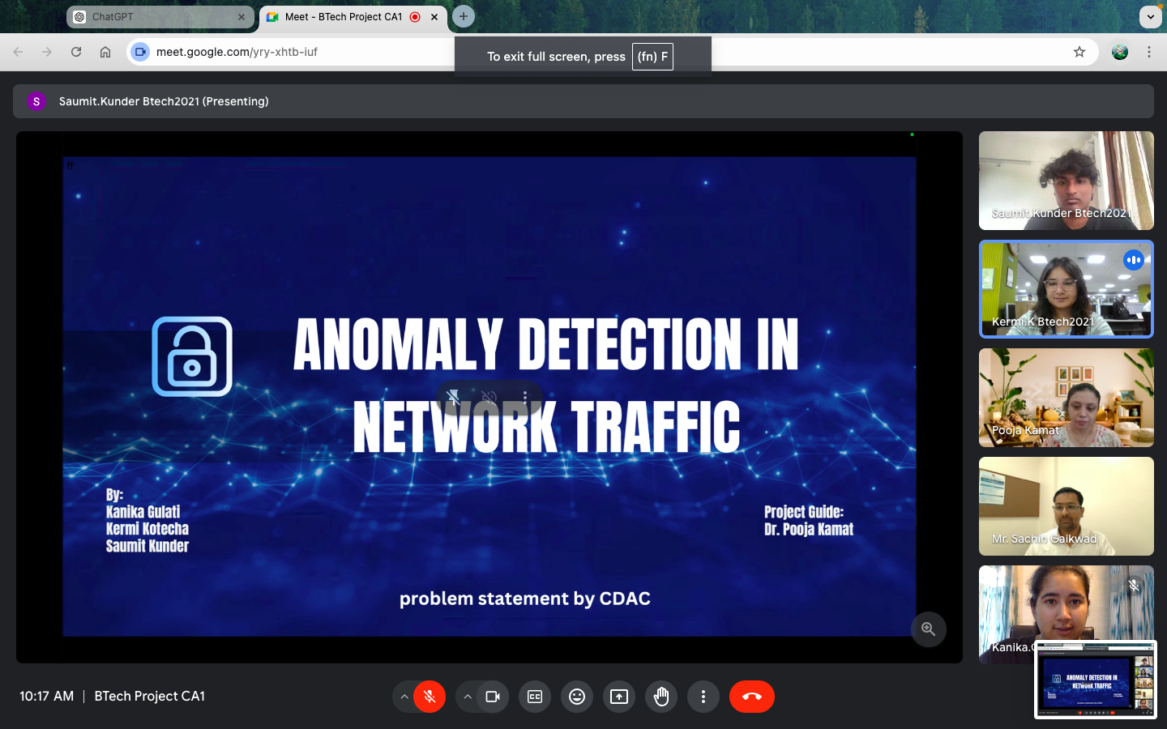
Photo of Presentation

Slide 20
Thankyou

